Slide 1
ITSC 306: Computer Forensics
Module 4, Week 6: Other Media, Devices and Hashing

Slide 2
Module Textbook Readings
Chapter 6

Slide 3
Removable Media
Capturing Removable Media is no different than collecting non-volatile data.
Similar to capturing hard disks, the process involves capturing and authenticating the data.
The same procedure of wiping target media and ensuring the suspect media is write-protected remains.
One difference is that removable media may have a write-protect tab which can be enabled, or in the case of optical disks, which may not be writable.

Slide 4
Types of Removable Media
Removable media can be purchased in a number of formats:
Memory cards, such as Secure Digital (SD, Mini SD, and Micro SD), Compact Flash (CF), and Memory Sticks
Optical disks (CD, DVD, Blue-Ray)
Magnetic tapes

Slide 5
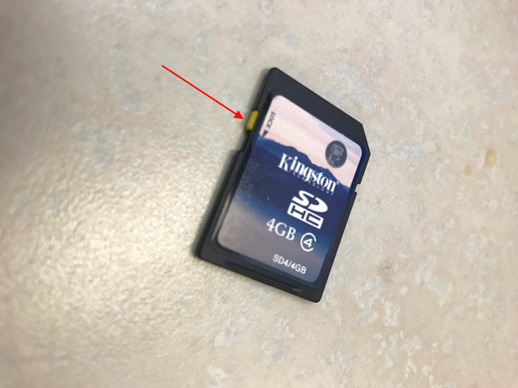
Removable Media – Write Protectors
In this example, the SD card has a lock that can be enabled to ensure that data is not written to the media.

Slide 6
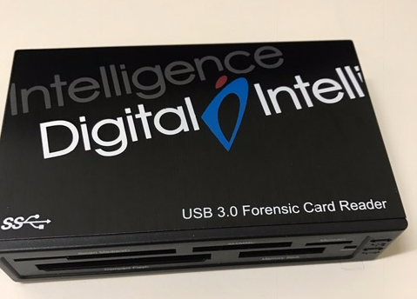
Removable Media – Write Protectors
If the media does not have a write-protector, a forensic card reader can be used.
The forensic card reader is a write-blocker for removable media.

Slide 7
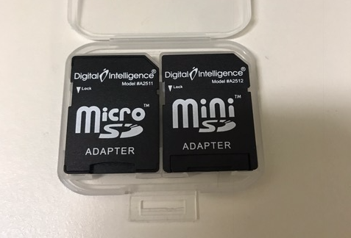
Removable Media
If the media is produced in different sizes, such as SD cards, adapters are used.

Slide 8
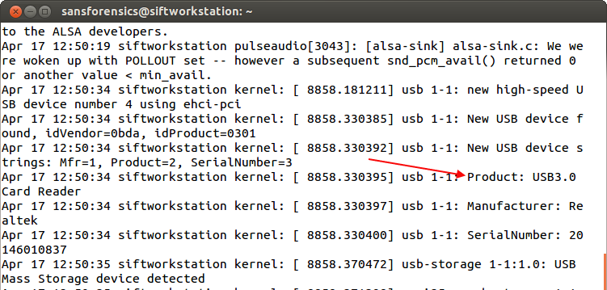
Removable Media
Running the command tail –f /var/log/syslog recognises the forensic card reader being attached.
Source: SANS Institute. Reproduced and used in accordance with the fair dealing provisions in section 29 of the Canadian Copyright Act for the purposes of education, research or private study. Further distribution may infringe copyright

Slide 9
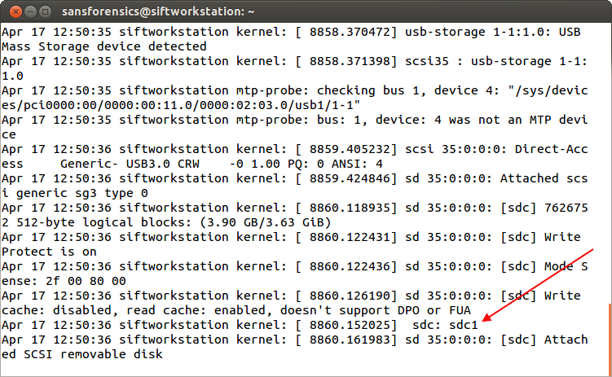
Removable Media
It also recognizes the SD card. The physical device is located and can be imaged at /dev/sdc or mounted at sdc1.
Source: SANS Institute. Reproduced and used in accordance with the fair dealing provisions in section 29 of the Canadian Copyright Act for the purposes of education, research or private study. Further distribution may infringe copyright

Slide 10
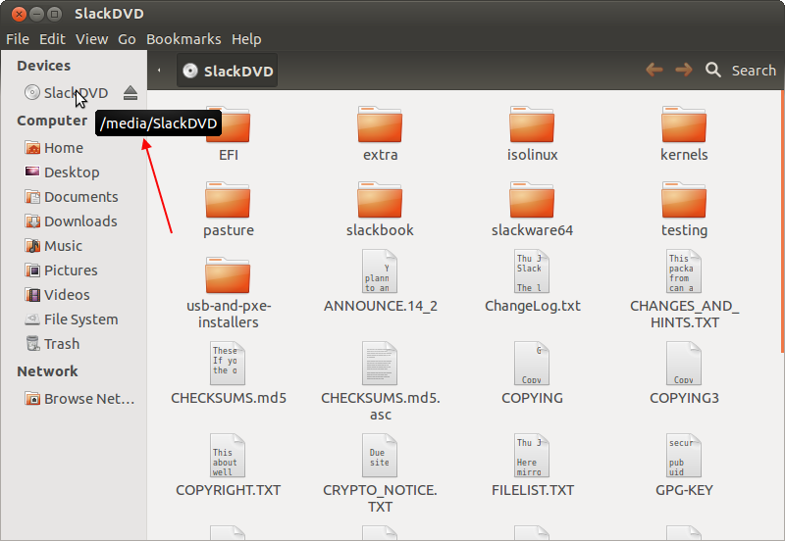
Optical Disks
In this example, the user inserted a Slackware DVD into their Linux system.
The DVD is mounted by the system at /media/SlackDVD.
Source: SANS Institute. Reproduced and used in accordance with the fair dealing provisions in section 29 of the Canadian Copyright Act for the purposes of education, research or private study. Further distribution may infringe copyright

Slide 11
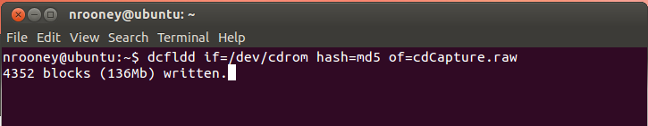
Optical Disks
The disk can now be captured using your known tools.
dcfldd if=/dev/cdrom hash=md5 of=cdCapture.raw
Source: SANS Institute. Reproduced and used in accordance with the fair dealing provisions in section 29 of the Canadian Copyright Act for the purposes of education, research or private study. Further distribution may infringe copyright

Slide 12
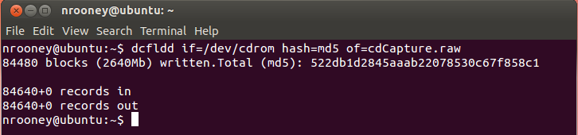
Optical Disks
Once completed, the image can be analyzed similar to other captures.
Source: SANS Institute. Reproduced and used in accordance with the fair dealing provisions in section 29 of the Canadian Copyright Act for the purposes of education, research or private study. Further distribution may infringe copyright

Slide 13
Magnetic Tapes
Magnetic tapes are found in businesses as back-up procedures.
Seizing tapes provide difficulties for the forensic analyst.
Comparable hardware will be required to read the tapes.
Back-up software may be needed to read the tapes.

Slide 14
Magnetic Tapes
If required, Linux has two main tape devices to read tapes:
/dev/st0 – Linux will rewind the tape after the task is performed.
/dev/nst0 – Linux will not rewind the tape.

Slide 15
Magnetic Tapes
If you seize a tape, how do you determine the block size to read the tape?
Reading and writing to tapes have specific block sizes depending on the tape.
Run the following command:
dd if=/dev/st0 bs=128k of=/tmp/dd_tape.bs count=1
dd reads the data 128 k at a time or stops if the bs is smaller, since we set our count to 1.
The true bs is the size of our output file dd_tape.bs.

Slide 16
RAIDs
Created to store data over two or more disks
Provide data security, speed and performance
Create problems for the investigator
Normally large (require a large amount of disk storage when capturing each disk)
The same RAID controller may be required to create the RAID
The investigator requires knowledge of the configuration to recreate the RAID

Slide 17
RAIDs
Although not impossible to reassemble and configure RAIDs to analyze data, it is not an easy process and the results beyond logical information will be minimal.
Similar to magnetic tapes, the standard process is to capture the logical volumes from a live system.
Capturing the logical data provides information that is available, it will have a smaller data set to capture, and is faster than imaging several disks and attempting to reassemble back at the lab.

Slide 18
Authenticating Captured Images
We have discussed the two-step process of capturing images: acquisition and authentication.
Authentication involves verifying that the data has not changed by way of a cryptographic hash.
Once evidence is hashed, data can be stored for days, months or years.
Hash value won’t change
Investigator can provide the data to another investigator. Both can confirm that the data hasn’t changed based on the hash value.

Slide 19
The Digital Fingerprint
A hash value is known as the digital fingerprint.
Based on the algorithm used, a hash value is created by taking data input of any length and producing a fixed-length hexadecimal number or hash value.
This hash value changes if one bit is changed.
The two most commonly used algorithms are md5 and sha1.
The standard Linux utilities are md5sum and sha1sum.

Slide 20
Hash Values – md5sum
md5 produces a 128-bit value, while sha1 produces a 160-bit value.
To create an md5 hash value on a physical device, attach the device and run the following command:
sudo md5sum /dev/(device)
sudo md5sum /dev/sdc
To authenticate and save the result, redirect the output to a text file:
sudo md5sum /dev/sdc > md5hash.txt

Slide 21
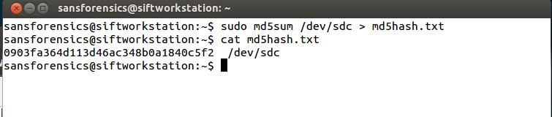
Hash Values – md5sum
Source: SANS Institute. Reproduced and used in accordance with the fair dealing provisions in section 29 of the Canadian Copyright Act for the purposes of education, research or private study. Further distribution may infringe copyright

Slide 22
Hash Values – sha1sum
To create a sha1 hash value on a physical device, attach the device and run the following command:
sudo sha1sum /dev/(device
sudo sha1sum /dev/sdc
To authenticate and save the result, redirect the output to a text file:
sudo sha1sum /dev/sdc > sha1hash.txt

Slide 23
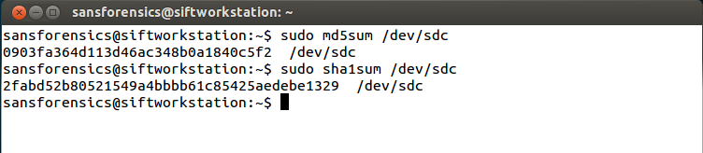
Hash Values – Output
Note the difference between the output of md5sum and sha1sum.
Source: SANS Institute. Reproduced and used in accordance with the fair dealing provisions in section 29 of the Canadian Copyright Act for the purposes of education, research or private study. Further distribution may infringe copyright

Slide 24
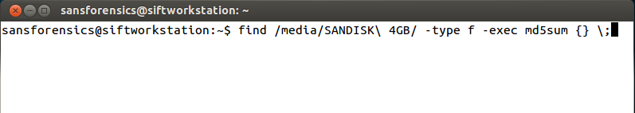
Recursively Hashing a Directory
A directory can be hashed recursively by running the find command to locate regular files and then executing md5sum against those files.
find /media/(mounted device) -type f –exec md5sum {} \;
find /media/SANDISK\ 4GB/ -type f –exec md5sum {} \;
Source: SANS Institute. Reproduced and used in accordance with the fair dealing provisions in section 29 of the Canadian Copyright Act for the purposes of education, research or private study. Further distribution may infringe copyright

Slide 25
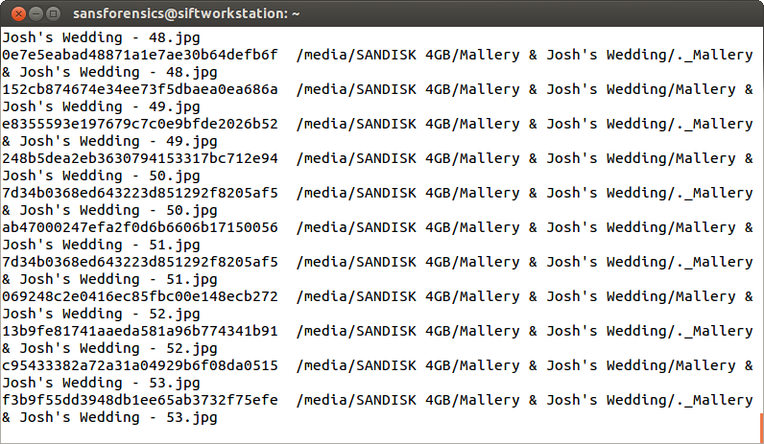
Recursively Hashing a Directory
The contents of the directories are hashed and directed to stdout.
Source: SANS Institute. Reproduced and used in accordance with the fair dealing provisions in section 29 of the Canadian Copyright Act for the purposes of education, research or private study. Further distribution may infringe copyright

Slide 26

Recursively Hashing a Directory
The results can also be directed to a text file.
find /media/SANDISK\ 4GB/ -type f –exec md5sum {} \; > hashList.txt
Source: SANS Institute. Reproduced and used in accordance with the fair dealing provisions in section 29 of the Canadian Copyright Act for the purposes of education, research or private study. Further distribution may infringe copyright

Slide 27
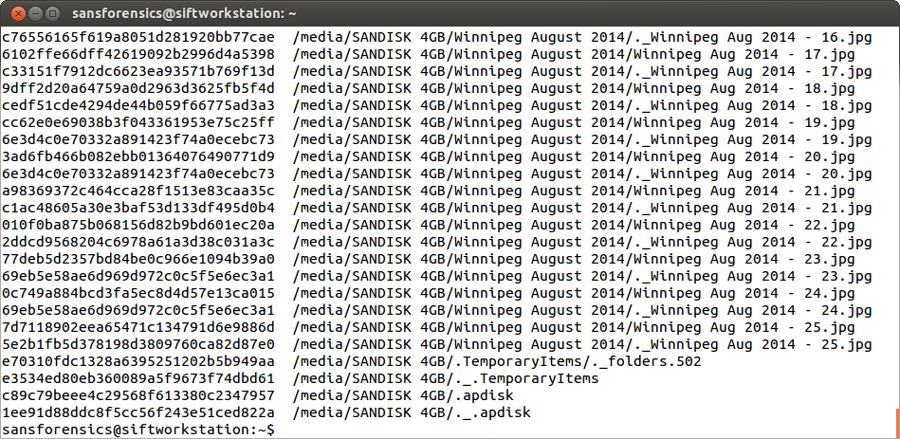
Recursively Hashing a Directory
Review the results by running cat hashList.txt.
Source: SANS Institute. Reproduced and used in accordance with the fair dealing provisions in section 29 of the Canadian Copyright Act for the purposes of education, research or private study. Further distribution may infringe copyright

Slide 28
md5deep - Examples
md5deep is another hashing program installed in SIFT.
To create a log of all files on a read only mounted device, run the following command:
md5deep –r /media/(Mounted Device)/ md5deep.txt
To view the output, run the cat command on the md5deep.txt file.

Slide 29
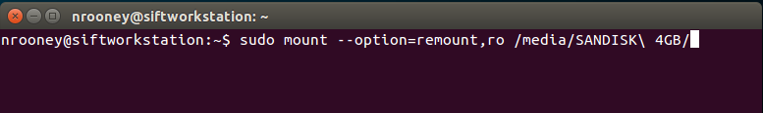
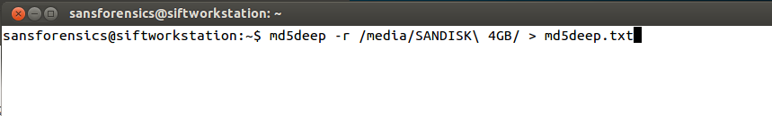
md5deep - Examples
Source: SANS Institute. Reproduced and used in accordance with the fair dealing provisions in section 29 of the Canadian Copyright Act for the purposes of education, research or private study. Further distribution may infringe copyright

Slide 30
md5deep - Examples
To estimate the time when authenticating a device, use the -e option:
md5deep –e /dev/sdc
To find only .jpeg files on read only mounted device, run the command:
find /media/(device)/ -iname “*.jpg” –exec md5deep {} \;

Slide 31
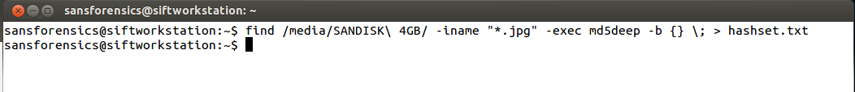
md5deep - Examples
To create a hash set of all .jpeg files on read only mounted device, run the command:
find /media/(device)/ -iname “*.jpg” –exec md5deep –b {} \; > hashset.txt
The -b option provides a bare output, so only the hash value and file name are displayed.
Source: SANS Institute. Reproduced and used in accordance with the fair dealing provisions in section 29 of the Canadian Copyright Act for the purposes of education, research or private study. Further distribution may infringe copyright

Slide 32
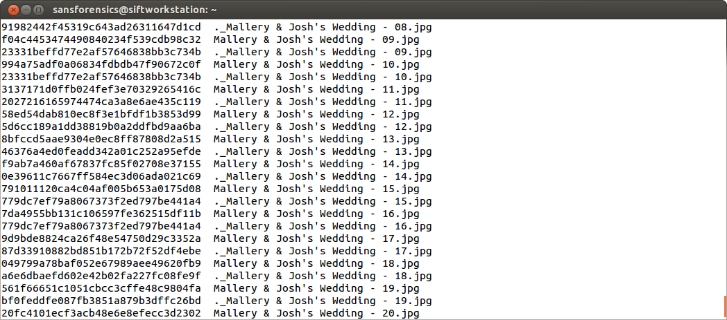
md5deep - Examples
Source: SANS Institute. Reproduced and used in accordance with the fair dealing provisions in section 29 of the Canadian Copyright Act for the purposes of education, research or private study. Further distribution may infringe copyright

Slide 33
Hashing a Device while Imaging
dcfldd and dc3dd have built in options to hash the device while imaging.
For dcfldd, add the hash option. Use md5, sha1, etc.
dcfldd if=/dev/sdc bs=4k conv=noerror of=image.raw hash=md5
dc3dd works the same way: add the hash option to the command. Use md5, sha1. etc.
dc3dd if=dev/sdc of=image2.raw hash=sha1

Slide 34
Summary
Capturing removable media involves the same procedure as capturing non-volatile data.
Capturing media such as SD cards, compact flash and memory sticks are easier to write-protect using a forensic card reader.
Magnetic tapes and RAID provide challenges for the investigator. Capture logical data involving tapes and RAIDs.
Authenticating data involves creating a “digital fingerprint” or hash value of the media.
A hash value ensures that integrity of the data by ensuring the data has not changed since the data was hashed.

Slide 35
References
SANS Institute (2017). SIFT Workstation [VMware Appliance]. Retrieved from https://digital-forensics.sans.org/community/downloads

Slide 36
© 2017, Southern Alberta Institute of Technology. All rights reserved.
This publication and materials herein are protected by applicable intellectual property laws. Unauthorized reproduction and distribution of this publication in whole or part is prohibited.
For more information, contact:
Director, Centre for Instructional Technology and Development
Southern Alberta Institute of Technology
1301 16 Ave. N.W., Calgary, AB T2M 0L4

